Slide 1
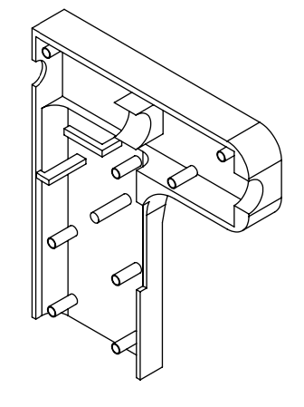
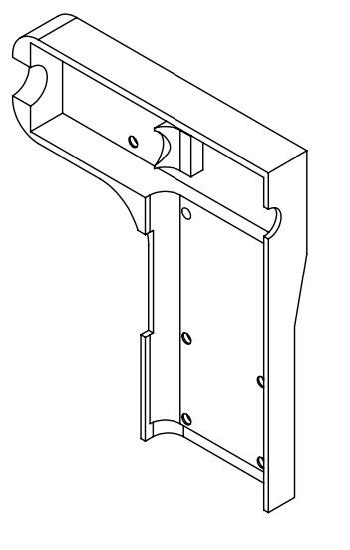
Detailed Design of Cordless Glue Gun
Presented by Team 2 – G²
Chenchu Sakthi Charan Kondugari, Chad Tucker, Samrudh U P, Chenyu Yang

Slide 2



Agenda
Product Schematic
Specifications of Components
CAD Drawings
Bill of Materials
Estimate of Raw Material
2

Slide 3
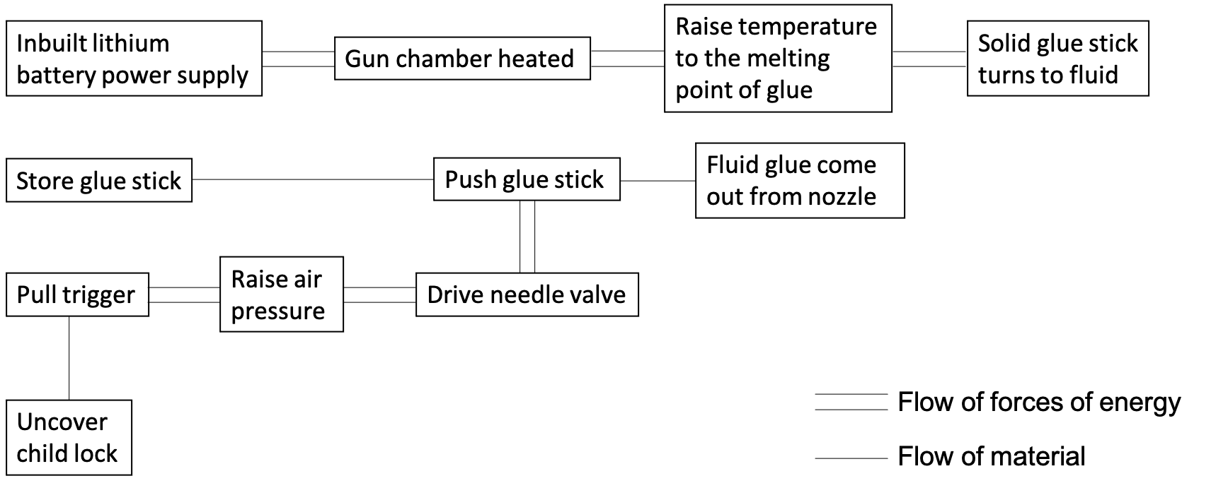
Product Schematic

Slide 4
Specifications of Components
Internal
Circuit board – provided by suppliers; support energy transformation
Coupler – provided by suppliers; support energy transformation
Spring steel – provided by suppliers; durable and flexible
Screw – provided by suppliers; low-cost
Linkage – durable
Gripper – strong
External
Tip – withstand high temperature (>M.P. of glue)
Trigger – durable
Outer shell – strong

Slide 5
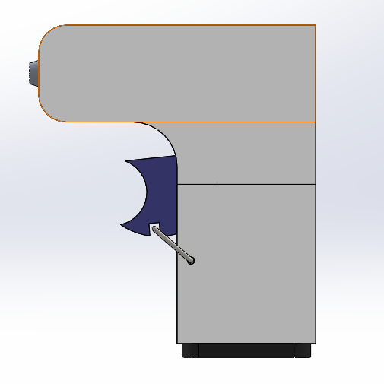
CAD Drawings
Our battery powered glue gun is comprised of 13 parts. Total weight is 1.55lbs without the battery.

Slide 6
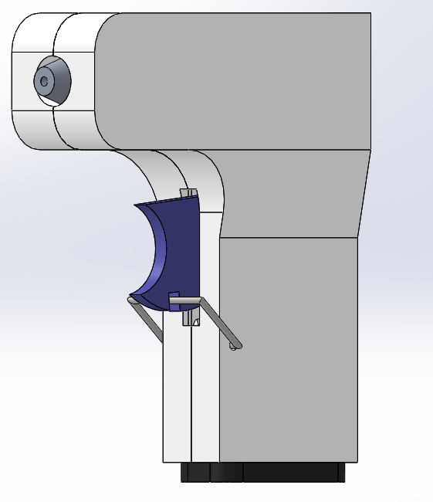
CAD Drawings
Glue tip which controls flow rate of glue out of the device
Accepts standard size glue sticks
Centered Mounted Trigger
Child Lock Mechanism
Inbuilt battery Pack

Slide 7
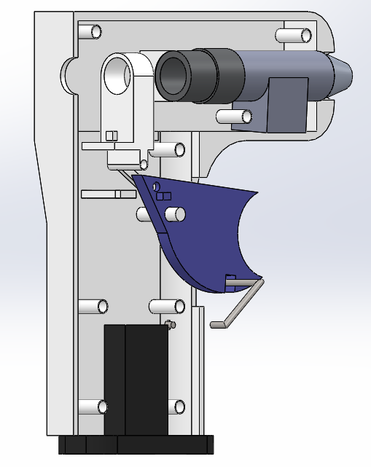
CAD Drawings

Slide 8
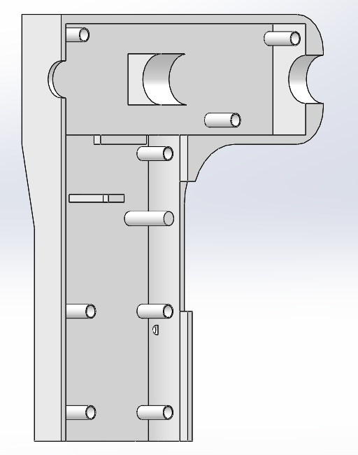
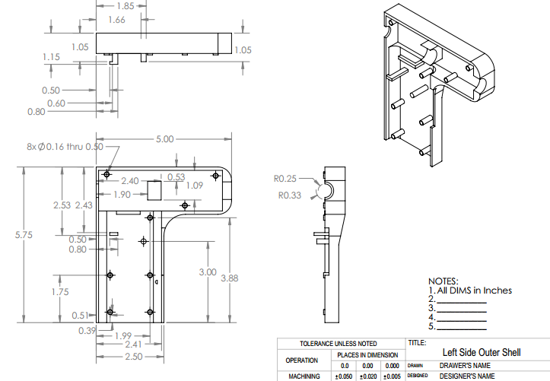
CAD Drawings

Slide 9
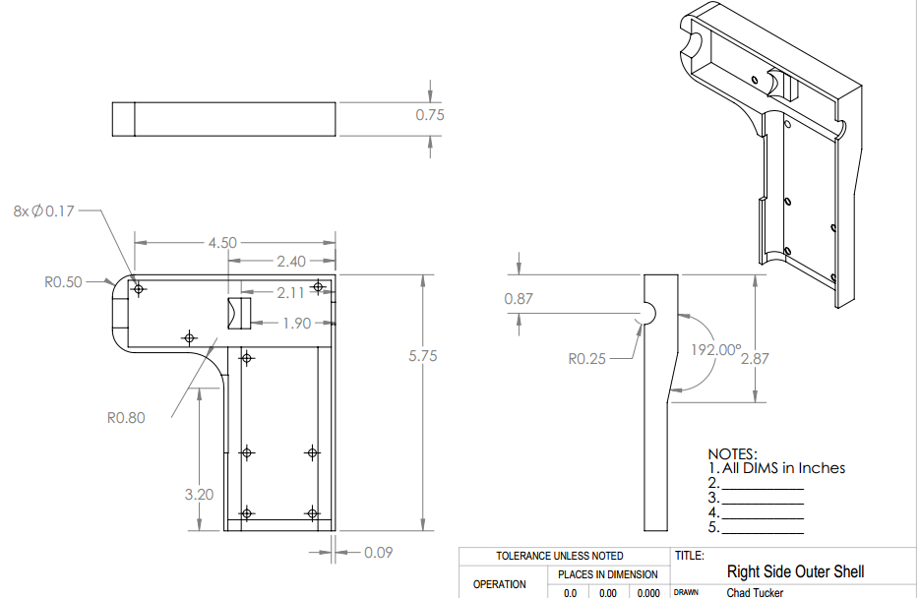
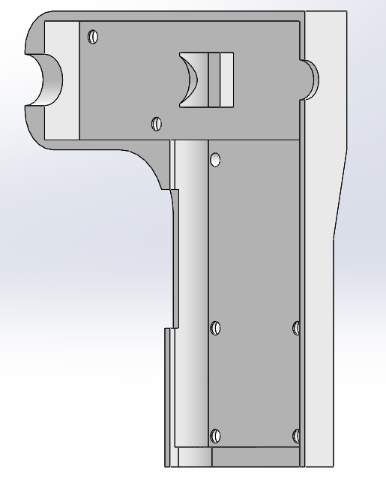
CAD Drawings

Slide 10
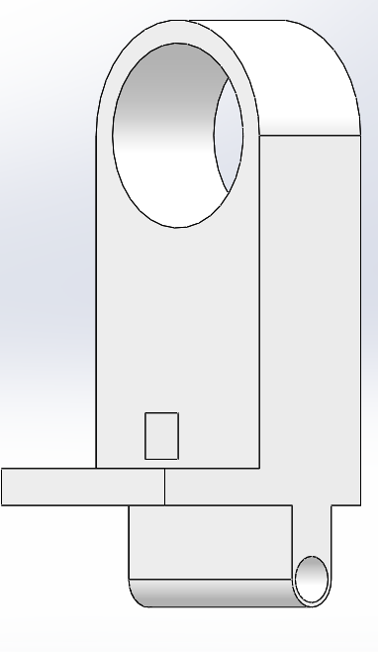
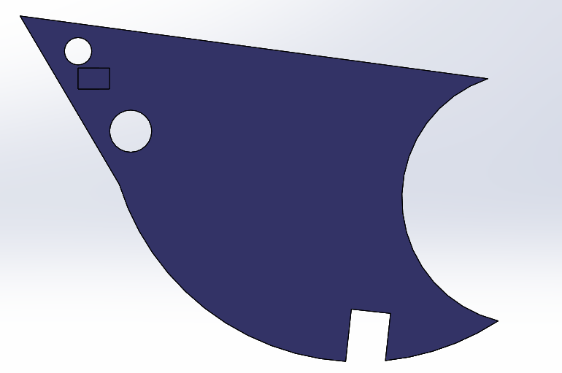
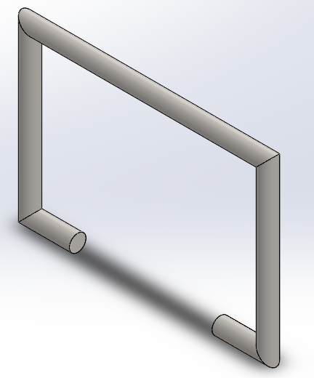
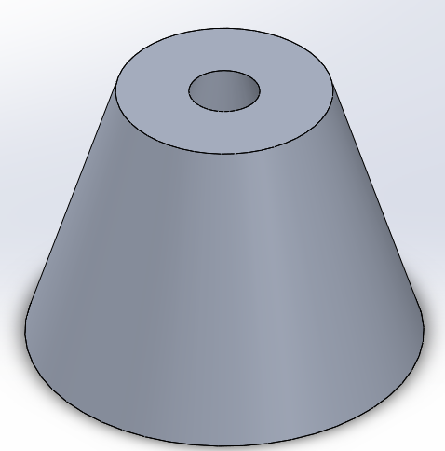
CAD Drawings
Trigger
Gripper
Safety Lock
Tip

Slide 11
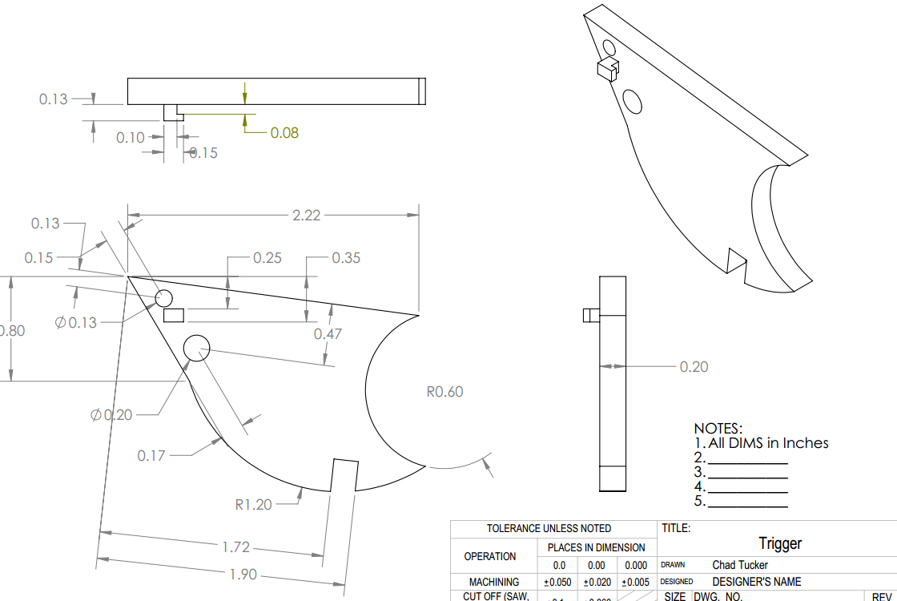
CAD Drawings

Slide 12
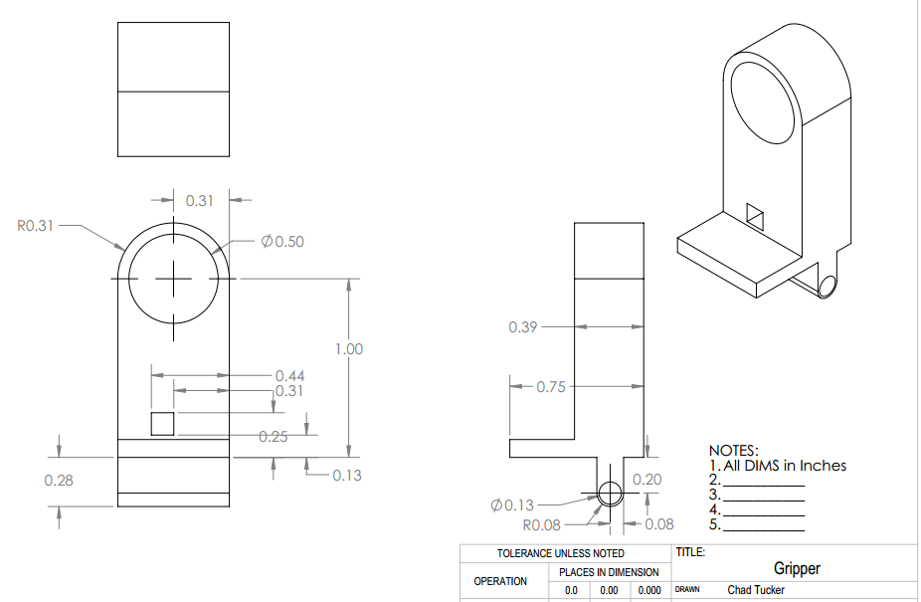
CAD Drawings

Slide 13
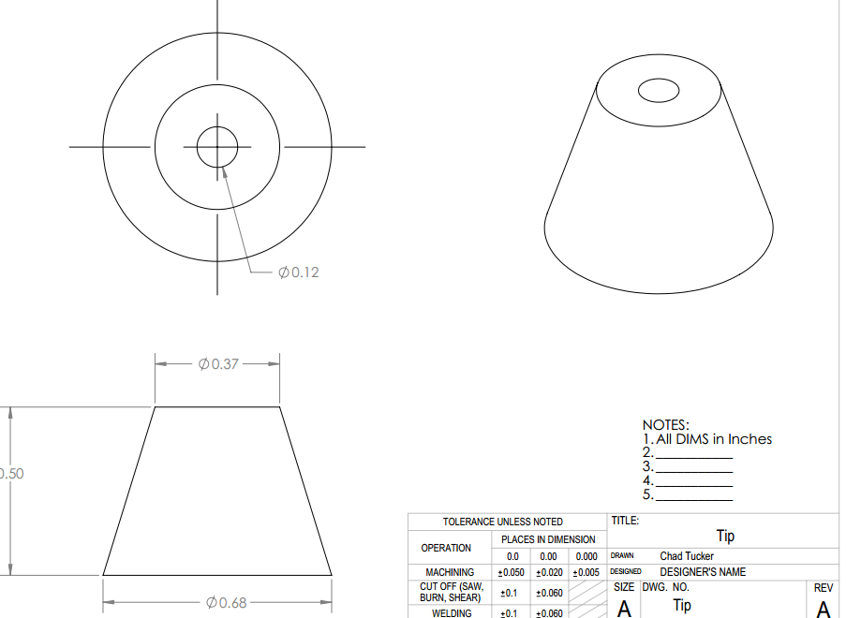
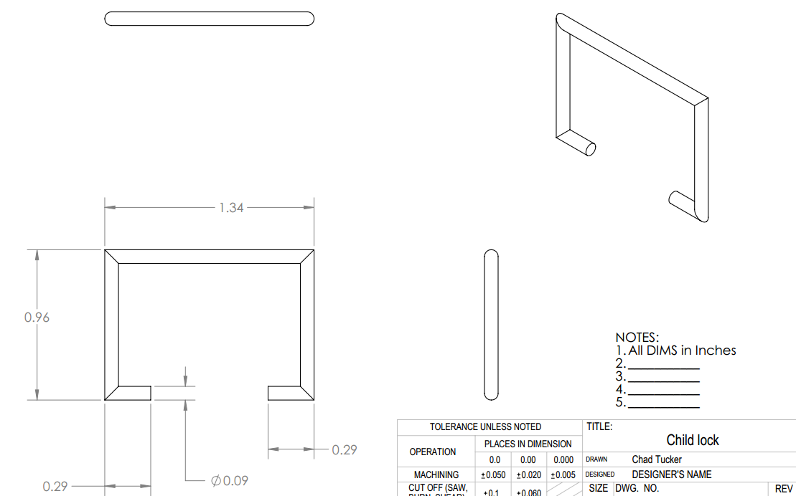
CAD Drawings

Slide 14
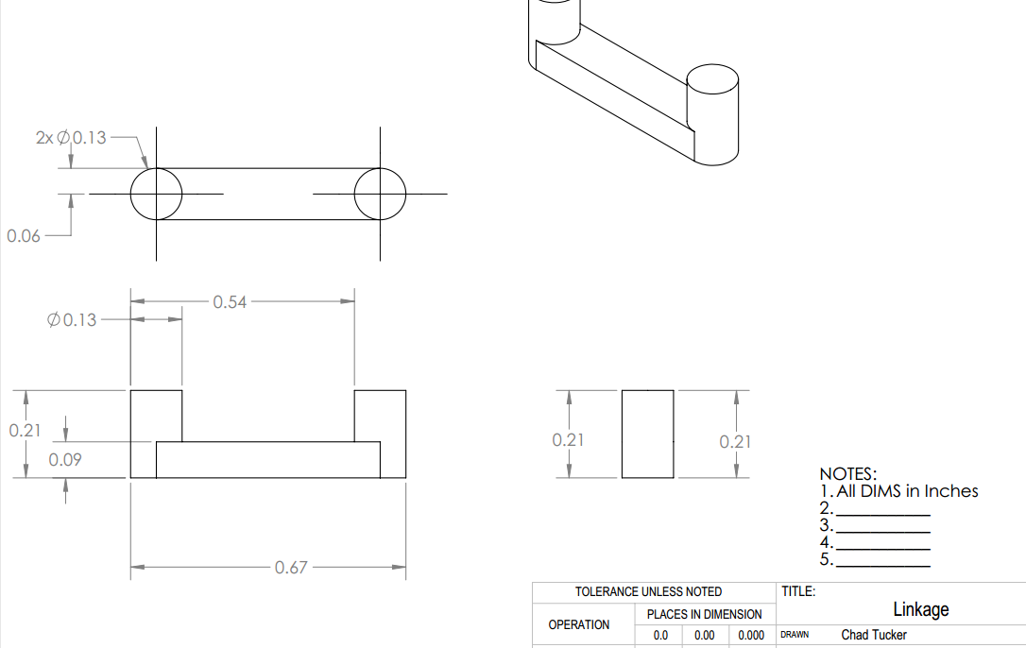
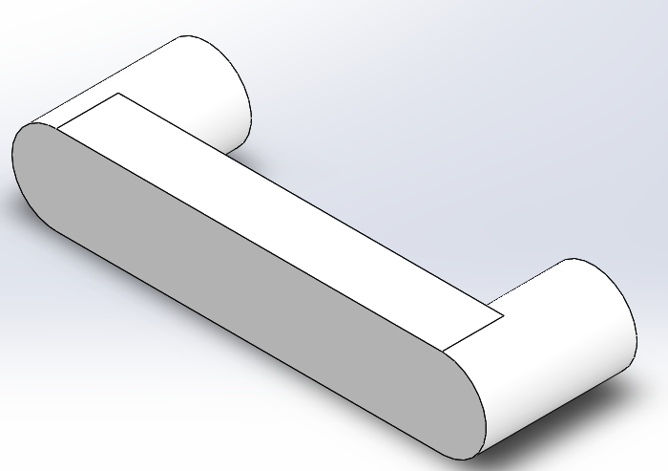
CAD Drawings

Slide 15
COTS Parts
Wiring from the Battery to the heater
Battery
#8 screws
Compression spring
Coupler

Slide 16
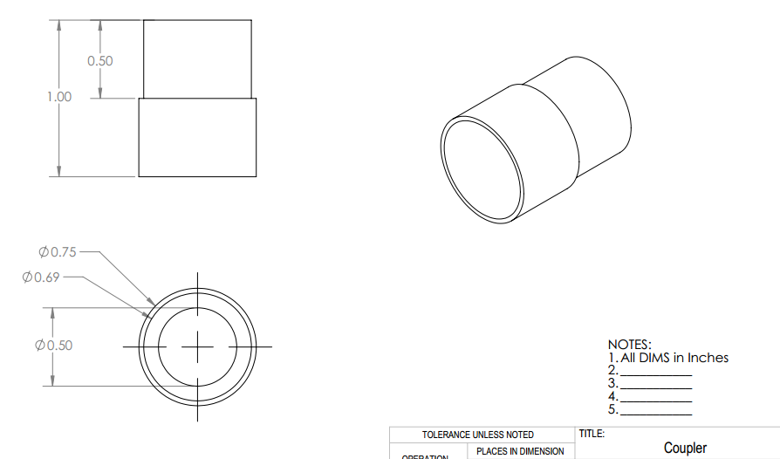
COTS Parts

Slide 17
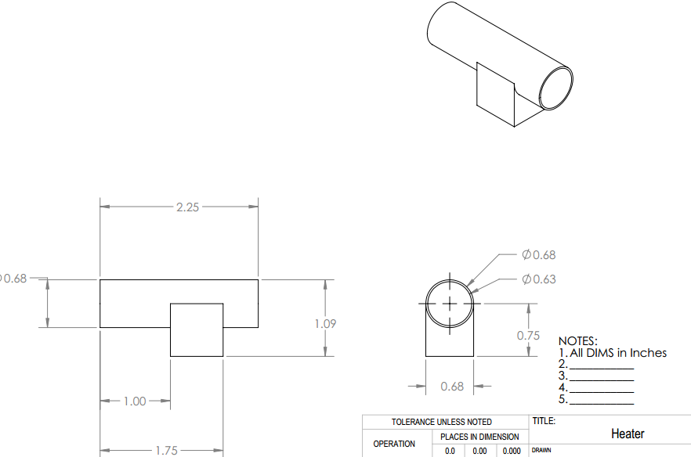
CAD Drawings

Slide 18
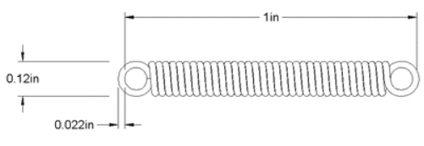
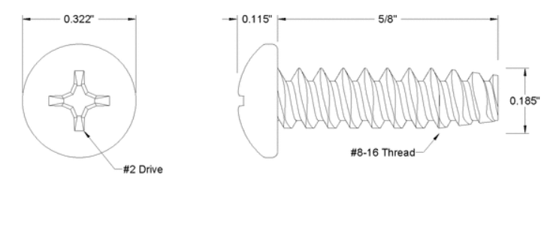
COTS Parts
Spring
Screws

Slide 19
Bill of Materials
Part | Material | Commercial-off-the-shelf (COTS) | Manufactured | Part number
Tip | 6061 Aluminum |  | Yes
Trigger | ABS Plastic |  | Yes
Linkage | ABS Plastic |  | Yes
Gripper | ABS Plastic |  | Yes
Coupler | Galvanized steel | Yes |  | mcmaster Part Number 7903N138
Child Lock | Carbon steel |  | Yes
Right side shell | ABS Plastic |  | Yes
Left side shell | ABS Plastic |  | Yes
Spring | Spring steel | Yes |  | mcmaster part number 5108N003
8 #8 screws | Steel | Yes |  | mcmaster part number 99461A350
Heater | Steel | Yes

Slide 20
Estimate of Raw Material
Part | Material | Commercial-off-the-shelf (COTS) | Manufactured | Cost of the material (per lb.) | No of unites produced per lb. | Wastage per lb. | Material cost per unit
Tip | 6061 Aluminum |  | Yes | $0.28 | 20 | %10 | $0.0154
Trigger | ABS Plastic |  | Yes | $1.5 | 20 | %10 | $0.0825
Linkage | ABS Plastic |  | Yes | $1.5 | 40 | %10 | $0.04125
Gripper | ABS Plastic |  | Yes | $1.5 | 12 | %10 | $0.1375
Coupler | Galvanized steel | Yes |  |  |  |  | $0.24
Child Lock | Carbon steel |  | Yes | $3 | 15 | %15 | $0.23
Right side shell | ABS Plastic |  | Yes | $1.5 | 8 | %25 | $0.46875
Left side shell | ABS Plastic |  | Yes | $1.5 | 8 | %25 | $0.46875
Spring | Spring steel | Yes |  |  |  |  | $2.08/4=$0.52
Glue gripper | ABS Plastic |  | Yes | $1.5 | 15 | %15 | $0.115
Heater | Steel | Yes |  |  |  |  | $2.34
Battery | Lithium-ion type | Yes |  |  |  |  | $4.50
 |  |  |  |  |  | Total | $9.15915

Slide 21
Q & A

